Slide 1

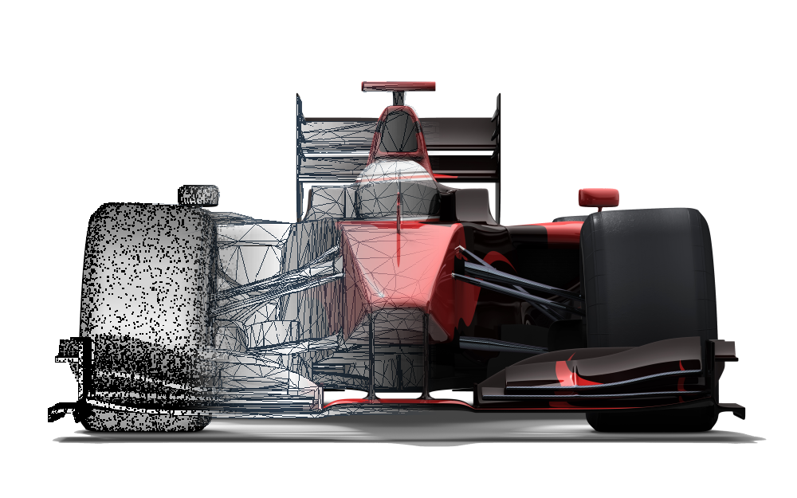
GRAND PRIX
Emiliano Sloth A01636165
Miriam Paulina Palomera A01635283

Slide 2
Overview
Our project was developed in the Golang programing language. The purpose of our project was to create a grand prix simulator through the use of goroutines, channels and locks
We invite you to give it a try with your friends and bet on who will the winner of the grand prix be.
Our application is available to all major operating systems: Windows, Mac and Linux

Slide 3
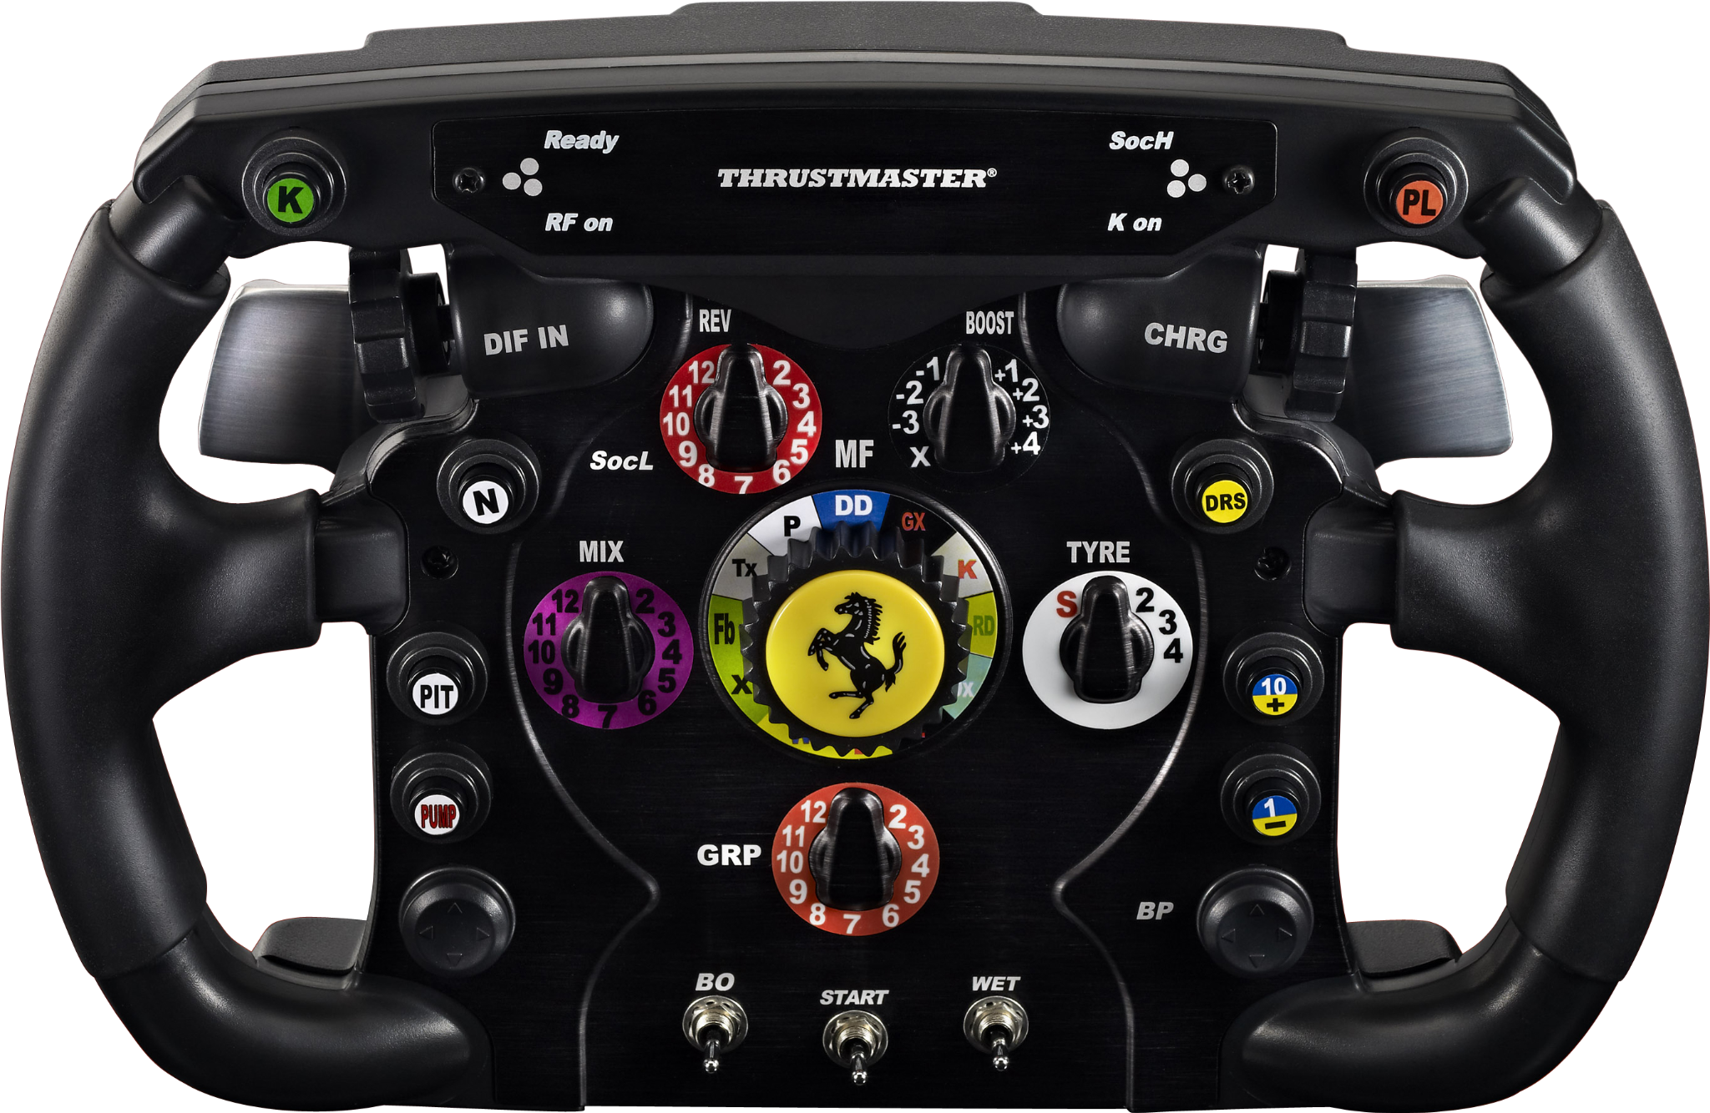
Architecture
Our track is s matrix of [5][90]
Speed of our pilots is calculated with rand.Intn(max-min) + min with min being 6 and max 12
Goroutines each one representing a different racer.
Managed collisions between cars by using locks
Synchronized the race using wait rooms

Slide 4
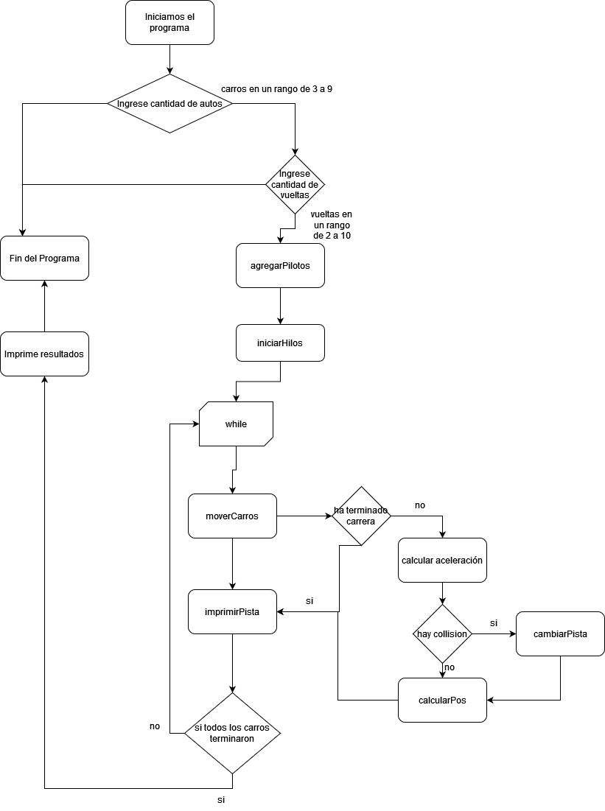
Flow Chart

Slide 5
Requirements

Slide 6
Quick tour on source code structure (focus in the key or challenging elements)
The race's lap can be static or automatically generated:
strCarros := scanner()
fmt.Print("\nPlease enter the number of vueltas (2-10): ")
Racers number can be configured on start:
fmt.Print("\nEnter number of racers (3-9): ")
strCarros := scanner()

Slide 7
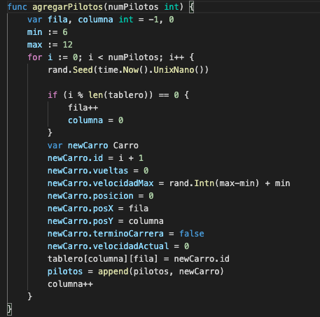
Define a random max speed for each car.
Our cars all have different max speeds within an interval so that competition is fair

Slide 8
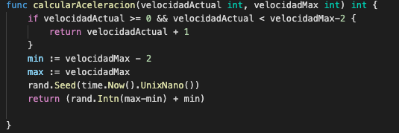
You will emulate the increasing speed behaviour that any car has.

Slide 9
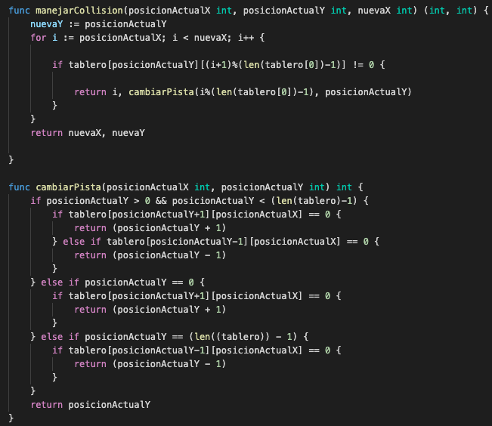
If a car detects another car on his route and its slower, it must slow down its speed or try to rebase it

Slide 10
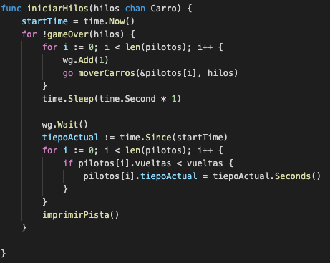
Each racer behaviour will be implemented as a separated thread

Slide 11
Cars threads must use the same map or city layout data structure resource
mu.Lock()
tablero[posicionActualY][posicionActualX] = 0
tablero[nuevaY][nuevaX] = carroActual.id
mu.Unlock()

Slide 12
Define how many laps before starting the race
strCarros := scanner()
fmt.Print("\nPlease enter the number of vueltas (2-10): ")

Slide 13
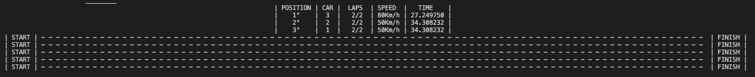
Display each car's speed, position, racing time and lap

Slide 14
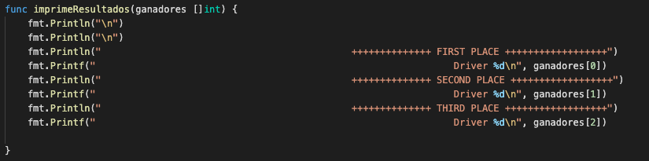
At the end, display the top 3 winners.

Slide 15
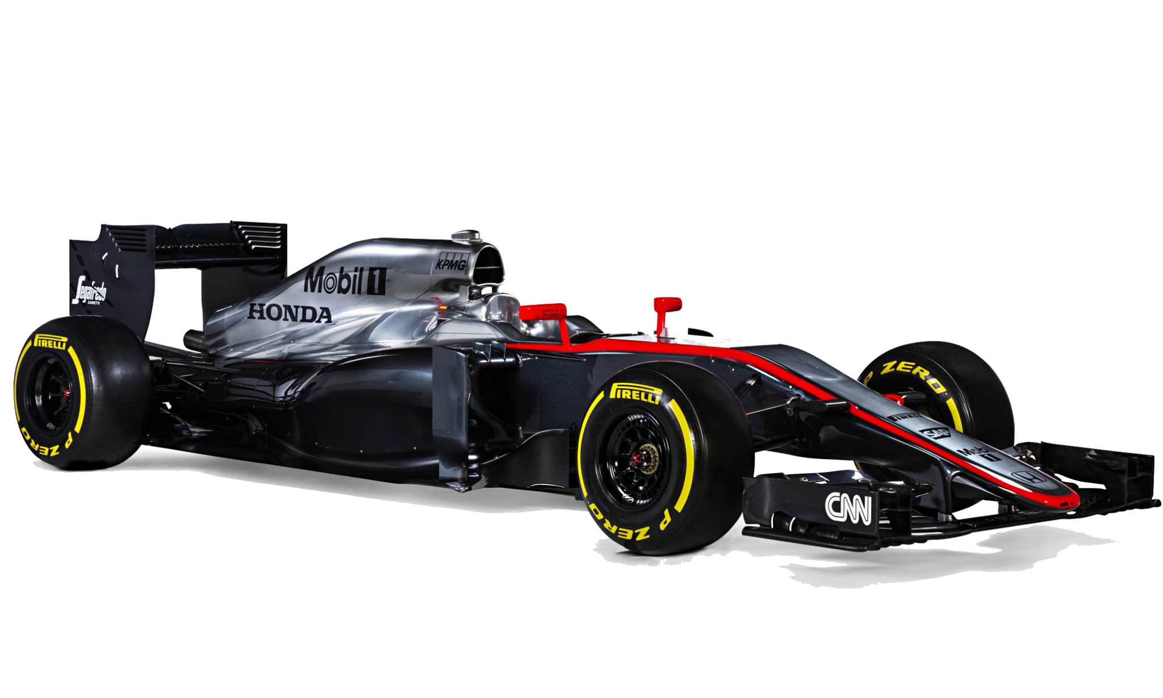
Demo

Slide 16
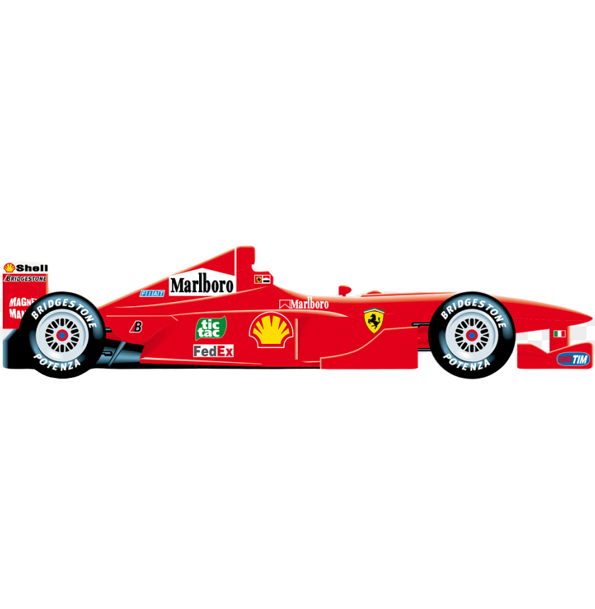
Key Learnings
A lot of Golang (It was both our first big project with this programming language)
Managing Bidimensional arrays and its pointers
Goroutines and prevent race conditions
The use of channels in go

Slide 17
Liga del video
Link: https://youtu.be/Jgrh8jJXod0

